Slide 1
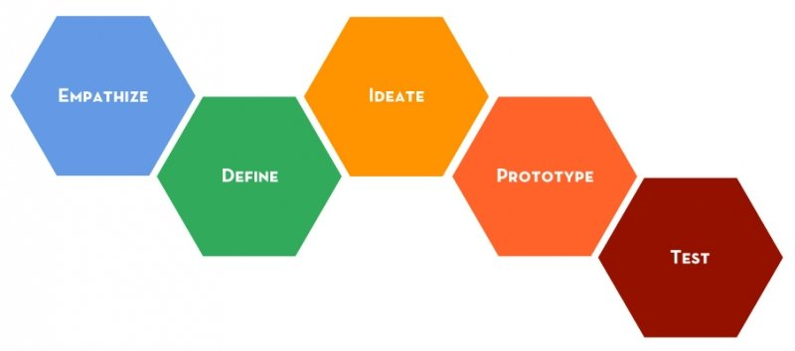
An intro into Design Thinking
CMGT engineer, designer & artist / Mark Boerrigter

Slide 2

Agenda
INTRO into the Module
WHAT is Design Thinking
WHY use Design Thinking
HOW to apply Design Thinking
PREPARING for the lab
REFERENCES

Slide 3

Intro
The module
WEEKLY LECTURES
WEEKLY LABS
The assignment
TEAM
Interactive prototype (tested)
Weekly deliverables in the lab hours
Presentation: investors pitch with design thinking results, team and process overview, interactive prototype and future iterations.

Slide 4
The assignment
Create an interactive prototype of one or more
media for a Transmedia storytelling experience
that is based on an existing Intellectual Property
> exact criteria: check the assessment form <

Slide 5
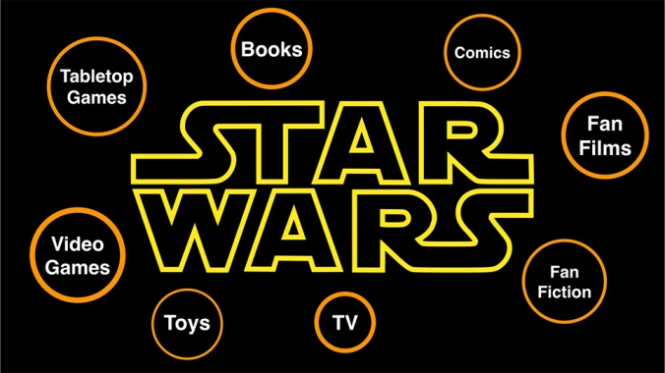
Transmedia storytelling

Slide 6
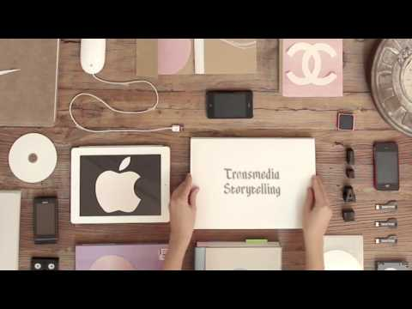
Transmedia storytelling
https://www.youtube.com/watch?v=CP-zOCl5md0

Slide 7
The process
Wk3: Intro
Lecture: intro Design Thinking and Scrum
Lab: experience Design Thinking, forming teams + selecting an IP for your assignment
Wk4: Empathy
Lecture: intro Empathy and Transmedia storytelling
Lab: creating an Empathy map for your assignment
Wk5: Define & Ideate
Lecture: intro Define & Ideate
Lab: defining your users actions, design space and problem statement + brainstorming on possible stories and solutions
Wk6: Prototype
Lecture: different ways / tools for prototyping
Lab: creating an interactive prototype
Wk7: Testing
Lecture: different ways / tools for user testing
Lab: testing your prototype + improvements
Wk8: Pitching
Lecture: 'how to pitch' + exam preparation
Lab: pitching your solution > price for best team!

Slide 8
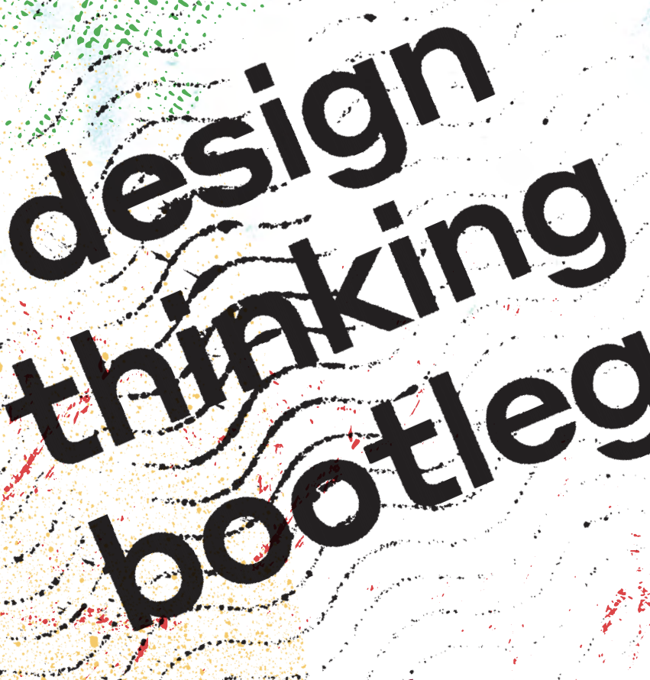
Additional info
Stanford Design School:
https://dschool.stanford.edu/resources/design-thinking-bootleg

Slide 9
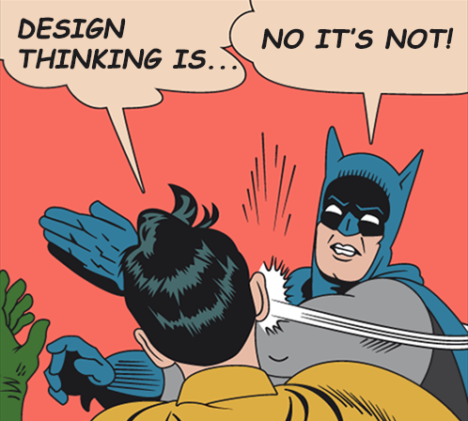
What is design thinking?

Slide 10

What is Design Thinking
Design thinking is a method for the practical, creative resolution of problems using the strategies designers use during the process of designing.
Design thinking has also been developed as an approach to resolve issues outside of professional design practice, such as in business and social contexts.
Source: wikipedia

Slide 11
Why Design Thinking
EMPATHIZE
IDEATE
DEFINE
PROTOTYPE
TEST

Slide 12
Why Design Thinking
Clearly articulate the problem you want to solve
Develop a (series of) prototype(s)
to test all or part of your solution
EMPATHIZE
IDEATE
Engage in a short-cycle testing process to refine and improve your solution
DEFINE
PROTOTYPE
Develop a deep under-standing of the challenge
Brainstorm potential solutions, select, and develop
TEST

Slide 13
Why Design Thinking
Capture findings
Problem statement
Mockups
Storyboards
Paper Prototypes
Fail Fast
EMPATHIZE
IDEATE
User tests
What works?
Iterate
DEFINE
PROTOTYPE
Interviewing
Observing
Immersion
Diverge
Converge
Feasibility
TEST

Slide 14
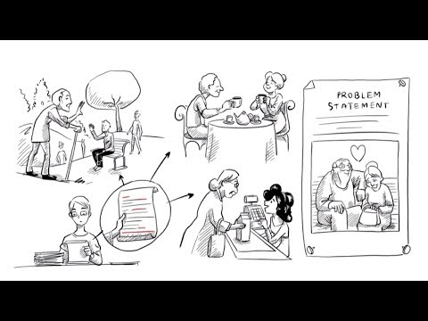
https://www.youtube.com/watch?v=_r0VX-aU_T8

Slide 15
https://www.people-doc.com/blog/design-thinking-case-studies
https://blog.prototypr.io/how-i-use-zombie-apocalypse-speculative-games-to-teach-design-driven-innovation-fdf5742c5716
https://www.gamasutra.com/blogs/MarsAshton/20181003/327768/At_Meaningful_Play_Design_Thinking_X_Game_Design.php

Slide 16

Why should you use design thinking?

Slide 17

Why should you use design thinking?

Slide 18

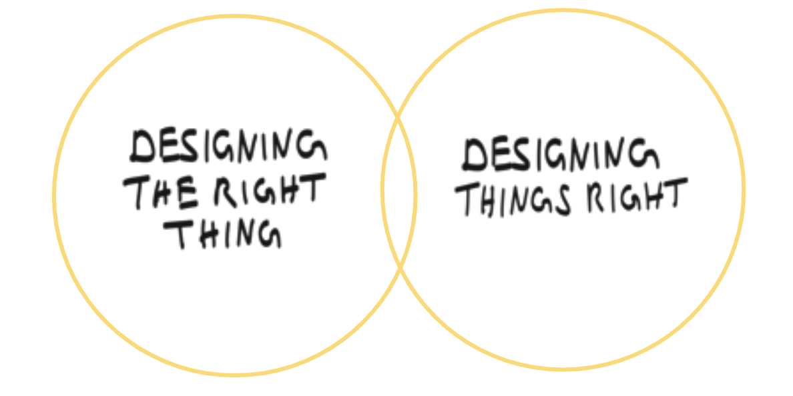
Why should you use design thinking?

Slide 19
Now look back at project Boarding call...

Slide 20
How to use Design thinking

Slide 21
Assume a beginner's mindset
You carry your own experiences, understanding, and expertise.
Your unique perspective is an incredibly valuable asset to bring to any design challenge.
At the same time, your viewpoint carries assumptions and personal beliefs. Your preconceived notions may, in fact, be misconceptions or stereotypes, and can limit the amount of real empathy you can build.
Assume a beginner’s mindset in order to put aside biases and approach a design challenge with fresh eyes.

Slide 22
How to assume a beginner's mindset
Don’t judge
Question everything
Be truly curious
Find patterns.
Listen. Really.

Slide 23
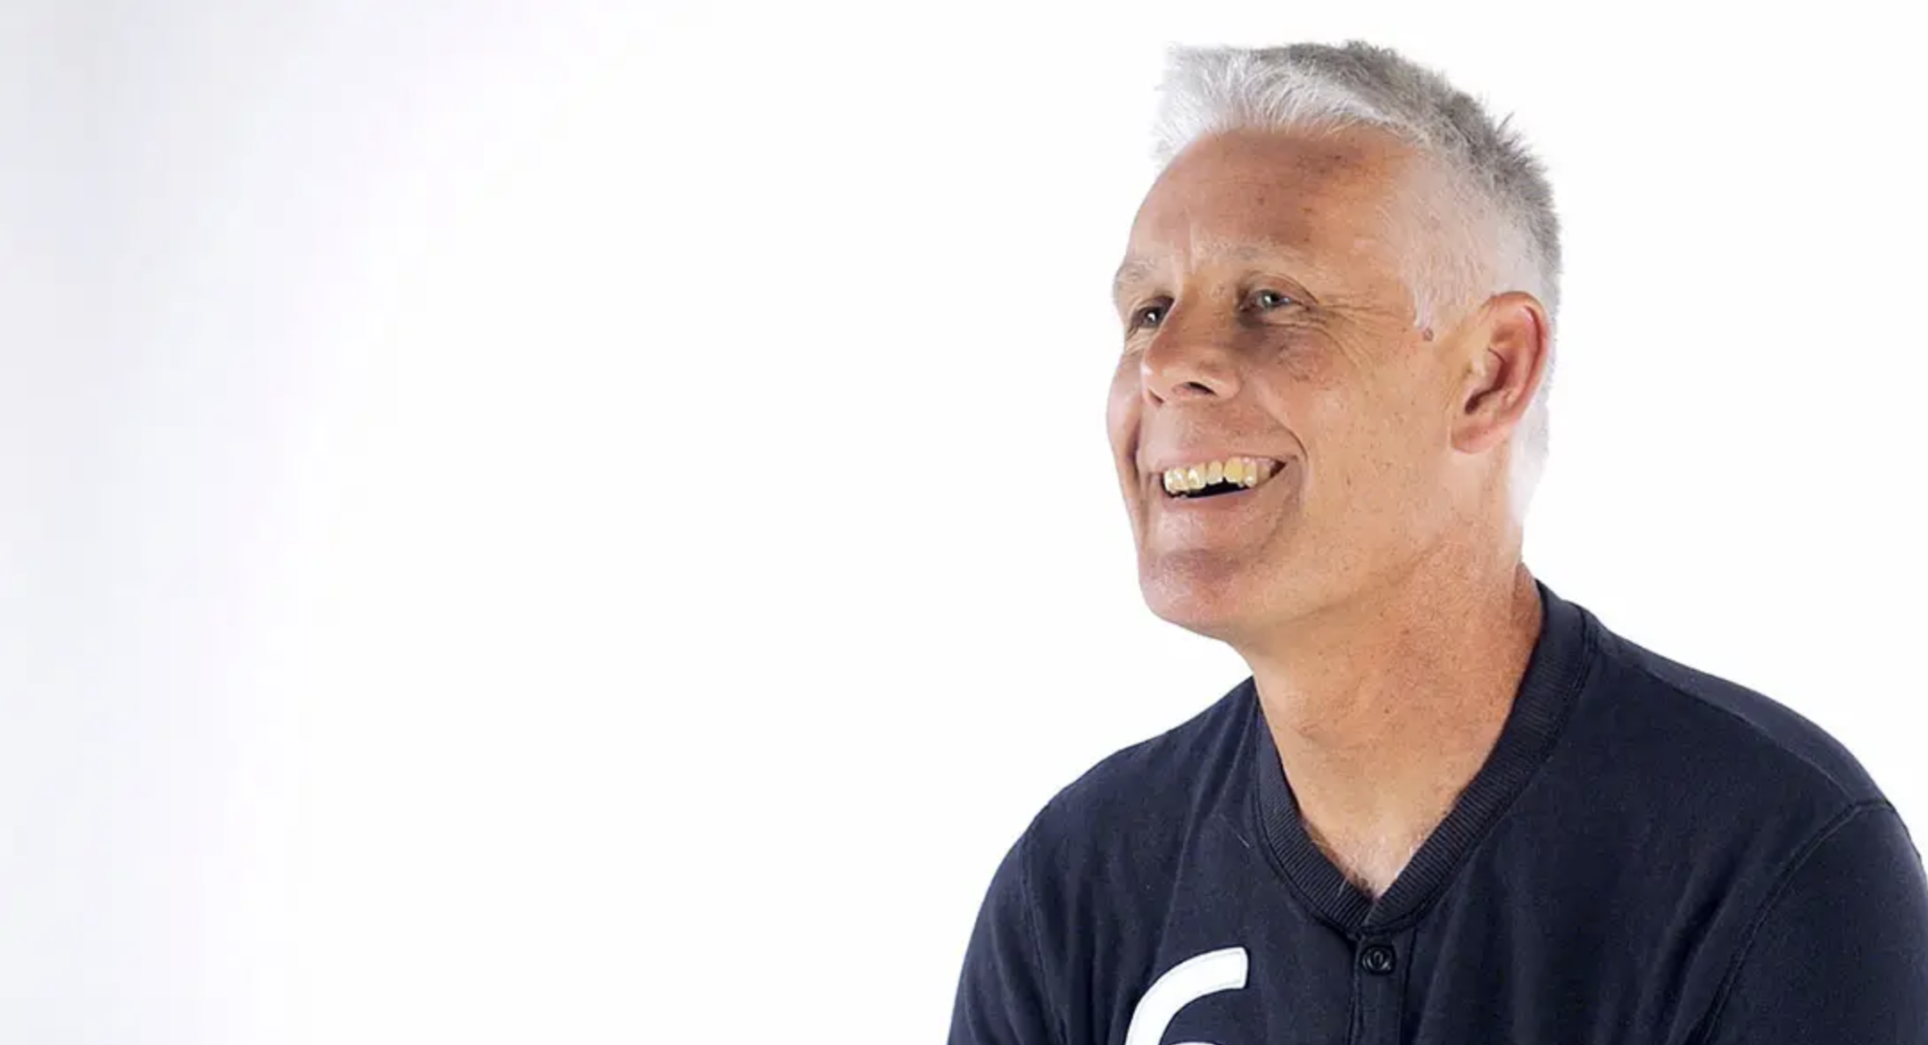
Be optimistic – Yes, and...
http://www.designkit.org/mindsets

Slide 24
Why Design Thinking
EMPATHIZE
IDEATE
DEFINE
PROTOTYPE
TEST

Slide 25
Empathize
Empathy is the foundation of humancentered design. The problems you’re trying to solve are rarely your own, they’re those of particular users.
Build empathy for your users by learning their values. The best solutions come from the best insights into human behavior. Discover the emotions that drive user behavior.
Uncover user needs (which they may or may not be aware of).
Identify the right users to design for.
Use your insights to design innovative solutions

Slide 26

Why Empathize?

Slide 27

How to Empathize
Observe
how users interact with their environment. Capture quotes, behaviors and other notes that reflect their experience. Watching users gives you clues as to what they think and feel— what they need.
Engage
users directly—interact with and interview them. Engaging users reveals deeper insights into their beliefs and values.
Immerse
yourself in your users’ experience. Find (or create if necessary) ways to immerse yourself in specific environments to understand first hand who you’re designing for.

Slide 28
Why Design Thinking
EMPATHIZE
IDEATE
DEFINE
PROTOTYPE
TEST

Slide 29
Define
The define mode is when you unpack your empathy findings into needs and insights and scope a meaningful challenge.
Based on your understanding of users and their environments, come up with an actionable problem statement (or Point of View).
Understanding the meaningful challenge at hand, and the user insights you can leverage, is fundamental to creating a successful solution.

Slide 30
Why Define?
Your problem statement

Slide 31
How to Define
The define mode explicitly expresses the problem you strive to address. In order to be truly generative, you must reframe your challenge based on new insights gained through your empathy work.
This reframed problem statement, can then be used as a solution-generating springboard.
A spectacular problem statement preserves emotion and the individual you’re designing for. Includes strong language. Uses sensical wording. Includes a strong insight. Generates lots of possibilities.

Slide 32
Why Design Thinking
EMPATHIZE
IDEATE
DEFINE
PROTOTYPE
TEST

Slide 33
Ideate
Ideate is the mode in which you generate radical design alternatives. Ideation is a process of “going wide” in terms of concepts and outcomes—a mode of “flaring” instead of “focus”.
The goal of ideation is to explore a wide solution space—both a large quantity and broad diversity of ideas.
From this vast repository of ideas, you can build prototypes to test with users.

Slide 34

Why Ideate?

Slide 35

How to Ideate

Slide 36
How to Ideate
Harness the collective perspectives and strengths of your team.
Step beyond obvious solutions and drive innovation.
Uncover unexpected areas of exploration.
Create fluency (volume) and flexibility (variety) in your innovation options.
Curtailing “bad” behaviors, such as evaluating during idea generation, is very important.

Slide 37
Why Design Thinking
EMPATHIZE
IDEATE
DEFINE
PROTOTYPE
TEST

Slide 38
Prototype
Prototyping gets ideas out of your head and into the world.
A prototype can be anything that takes a physical form—a wall of post-its, a role-playing activity, an object.
In early stages, keep prototypes inexpensive and low resolution to learn quickly and explore possibilities.
Prototypes are most successful when people (the design team, users, and others) can experience and interact with them. They’re a great way to start a conversation.
What you learn from interactions with prototypes drives deeper empathy and shapes successful solutions.

Slide 39
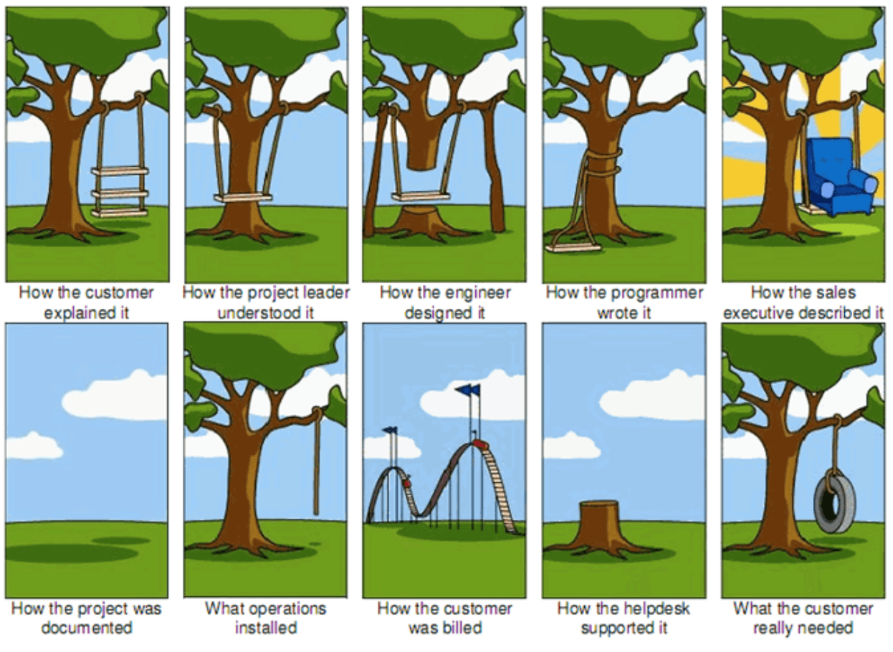
Why Prototype?

Slide 40
How to Prototype
Just start building
01
Don’t spend too much time
02
Remember what you’re testing for
03
Build with the user in mind
04
Test the prototype against your expected user behaviours and user needs.
05

Slide 41
Why Design Thinking
EMPATHIZE
IDEATE
DEFINE
PROTOTYPE
TEST

Slide 42
Testing
Testing is your chance to gather feedback, refine solutions, and continue to learn about your users.
The test mode is an iterative mode in which you place low-resolution prototypes in the appropriate context of your user’s life.
Prototype as if you know you’re right, but test as if you know you’re wrong.

Slide 43
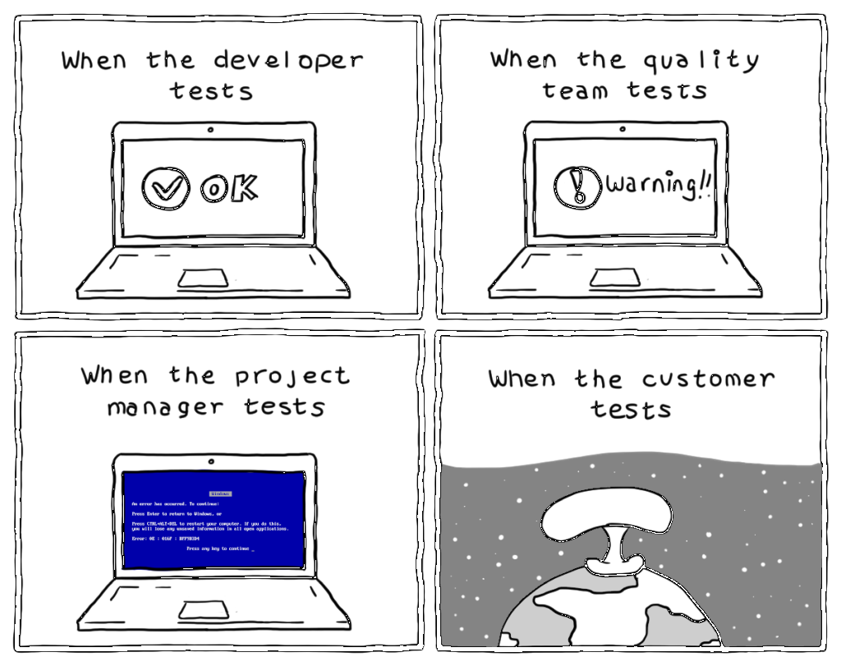
Why Test?

Slide 44
How to Test
Create authentic experiences for users to test your prototypes.
Learn more about your user. Testing is another opportunity to build empathy through observation and engagement—often yielding unexpected insights.
Refine your prototypes and solutions. Testing informs the next iterations of prototypes. Sometimes this means going back to the drawing board.
Test and refine your Point of View. Testing may reveal that, not only did you get the solution wrong, but you also framed the problem incorrectly.

Slide 45
Why Design Thinking
EMPATHIZE
IDEATE
DEFINE
PROTOTYPE
TEST

Slide 46
And then what?
Back to the drawing board
Iterate
Cash!

Slide 47

Case
Extra knowledge
Surviving the Zombie Apocalypse

Slide 48

...BRRAAIINNNSSS....
There is a Zombie outbreak on the streets. We need to get to the glass building for transport to safety.
You have access to all the resources of this building, and your challenge is to explore how might we create a way for the entire group (10% loss is accepted) to cross the street alive.

Slide 49

1. EMPHATHIZE
What do you know about our group?
What do you know about zombies?
What do you know about this building?
What do you know about the streets?
What do you know about....

Slide 50

2. DEFINE
What are the most important insights?
What are the most important needs?
What is our problem statement?
How can we (users)…. create a way to …. (needs)… because … (insights)...

Slide 51

3. IDEATE
Sketch at least 3 ways to meet our needs

Slide 52
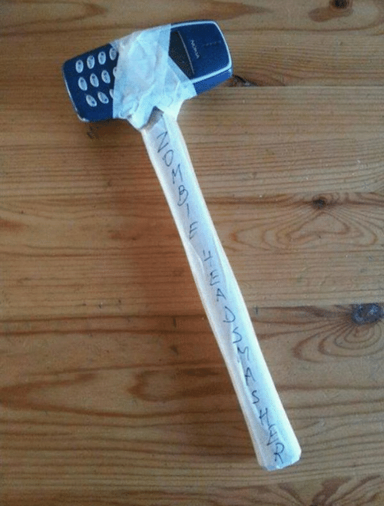
4. PROTOTYPE
How could we prototype these solutions as fast as possible?

Slide 53

5. TEST
How could we test these solutions?

Slide 54
Transfer
Extra knowledge
From lecture to knowledge

Slide 55
What is design thinking?
EMPATHIZE
IDEATE
DEFINE
PROTOTYPE
TEST

Slide 56
Assignment LAB hours
As a <student> I want to <experience the design thinking process>, so that <I can understand and apply it for this project>.
As a <product owner>, I want to <select a known IP>, so that I <can start researching the IP for the empathy phase> .

Slide 57
References
Design Thinking Bootcamp Bootleg. (2018). Stanford d.school. Retrieved 15 August 2018, from https://dschool.stanford.edu/resources/the-bootcamp-bootleg
Design Thinking Bootleg . (2018). Stanford d.school. Retrieved 15 August 2018, from https://dschool.stanford.edu/resources/design-thinking-bootleg

